Slide 1
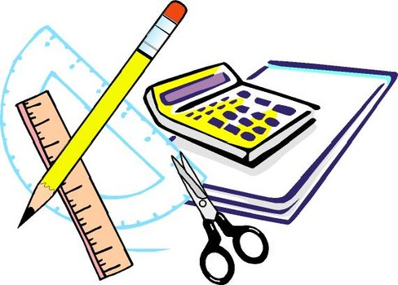
Learning Objective
I will calculate probabilities from tree diagrams.
Enter quietly, please be ready with the following on your desk:
Whiteboard
Whiteboard marker
Exercise Book
Pencil, pen, ruler and red pen
Diary
Calculator
Device – charged or borrowed from Library before maths

Slide 2
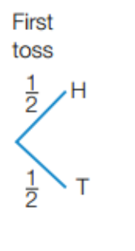
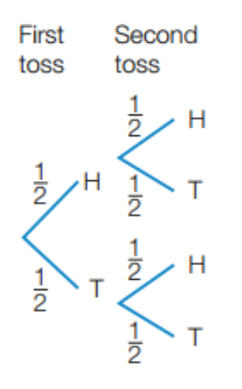
Concept Development
If we toss a coin once, we can create the following tree diagram to represent the probability of each outcome.
There are two equally likely outcomes,
Pr(H) = Pr(T) = ½
If we toss a coin twice, we can create the following tree diagram to represent the probability of each outcome.
There are four equally likely outcomes,
Pr(HH) = Pr(HT) = Pr(TH) = Pr(TT) = ¼

Slide 3
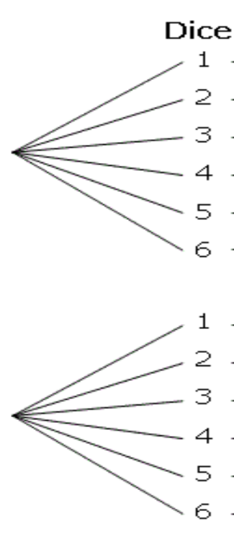
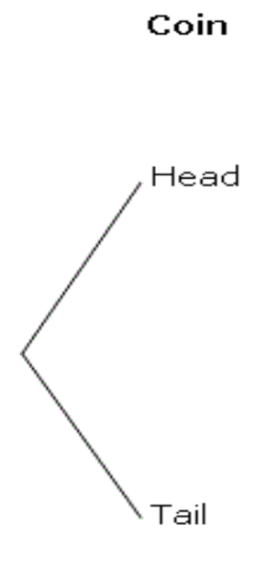
Daily Review
Step 1: draw 2 lines for the outcome of the 1st event
(ensure they are lined up)
Step 2: draw 12 lines for the outcome of the 2nd event
(ensure they are lined up)
A coin is flipped and a dice is rolled.
Draw a tree diagram showing the results.
What is the probability of getting:
1/12
A head and a 4?

Slide 4
Daily Review
Step 1: draw 2 lines for the outcome of the 1st event
(ensure they are lined up)
Step 2: draw 12 lines for the outcome of the 2nd event
(ensure they are lined up)
A coin is flipped and a dice is rolled.
Draw a tree diagram showing the results.
What is the probability of getting:
1/12
A head and a 4?
1/12
A tail and a 5?

Slide 5
Daily Review
Step 1: draw 2 lines for the outcome of the 1st event
(ensure they are lined up)
Step 2: draw 12 lines for the outcome of the 2nd event
(ensure they are lined up)
A coin is flipped and a dice is rolled.
Draw a tree diagram showing the results.
What is the probability of getting:
1/12
A head and a 4?
1/12
A tail and a 5?
3/12 = 1/4
A head and an even?

Slide 6
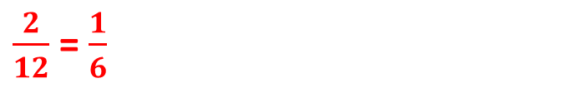
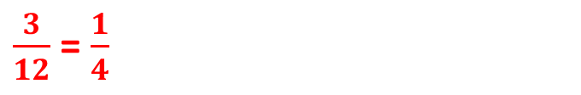


Daily Review
Step 1: draw 2 lines for the outcome of the 1st event
(ensure they are lined up)
Step 2: draw 12 lines for the outcome of the 2nd event
(ensure they are lined up)
A coin is flipped and a dice is rolled.
Draw a tree diagram showing the results.
What is the probability of getting:
$$\frac{1}{12}$$
A head and a 4?
$$\frac{1}{12}$$
A tail and a 5?
$\frac{3}{12}$ = $\frac{1}{4}$
A head and an even?
$\frac{2}{12}$ = $\frac{1}{6}$
A tail and less than 3?

Slide 7
Daily Review
Step 1: draw 2 lines for the outcome of the 1st event
(ensure they are lined up)
Step 2: draw 12 lines for the outcome of the 2nd event
(ensure they are lined up)
A coin is flipped and a dice is rolled.
Draw a tree diagram showing the results.
What is the probability of getting:
1/12
A head and a 4?
1/12
A tail and a 5?
3/12 = 1/4
A head and an even?
2/12 = 1/6
A tail and less than 3?
4/12 = 1/3
A tail and more than 2?

Slide 8
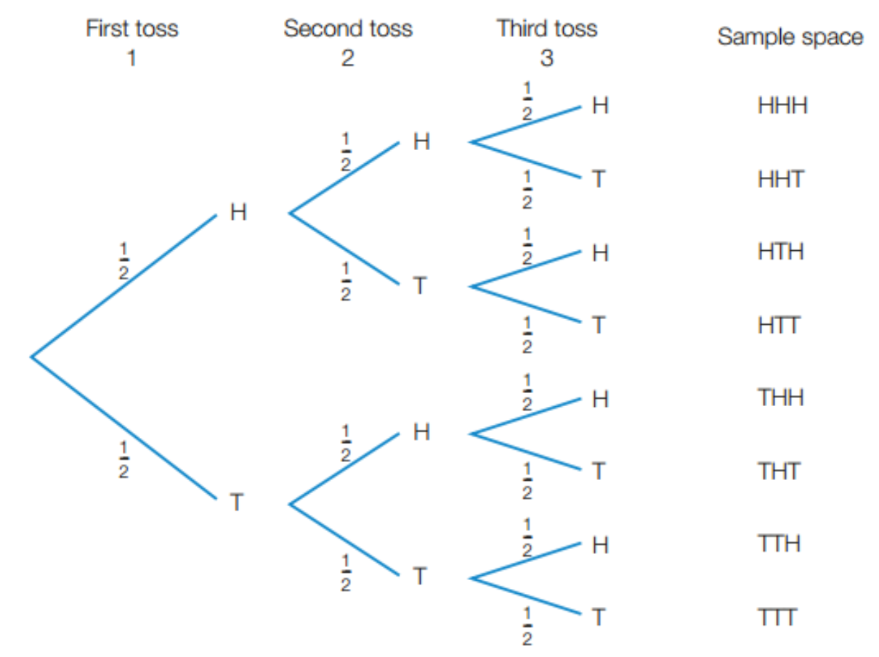

Concept Development
If we toss a coin three times, we can create the following tree diagram to represent the probability of each outcome.
There are eight equally likely outcomes,
Pr(HHH) = Pr(HHT) = Pr(HTH) = Pr(HTT)
= Pr(THH) = Pr(THT) = Pr(TTH) = Pr(TTT) = 1/8
Because all the outcomes are equally likely, we can just count how many successful ones there are.
We could also calculate the probability by multiplying along the branches.
Eg. Pr(HHH)
$$=\frac{1}{2}×\frac{1}{2}×\frac{1}{2}= \frac{1}{8}$$

Slide 9
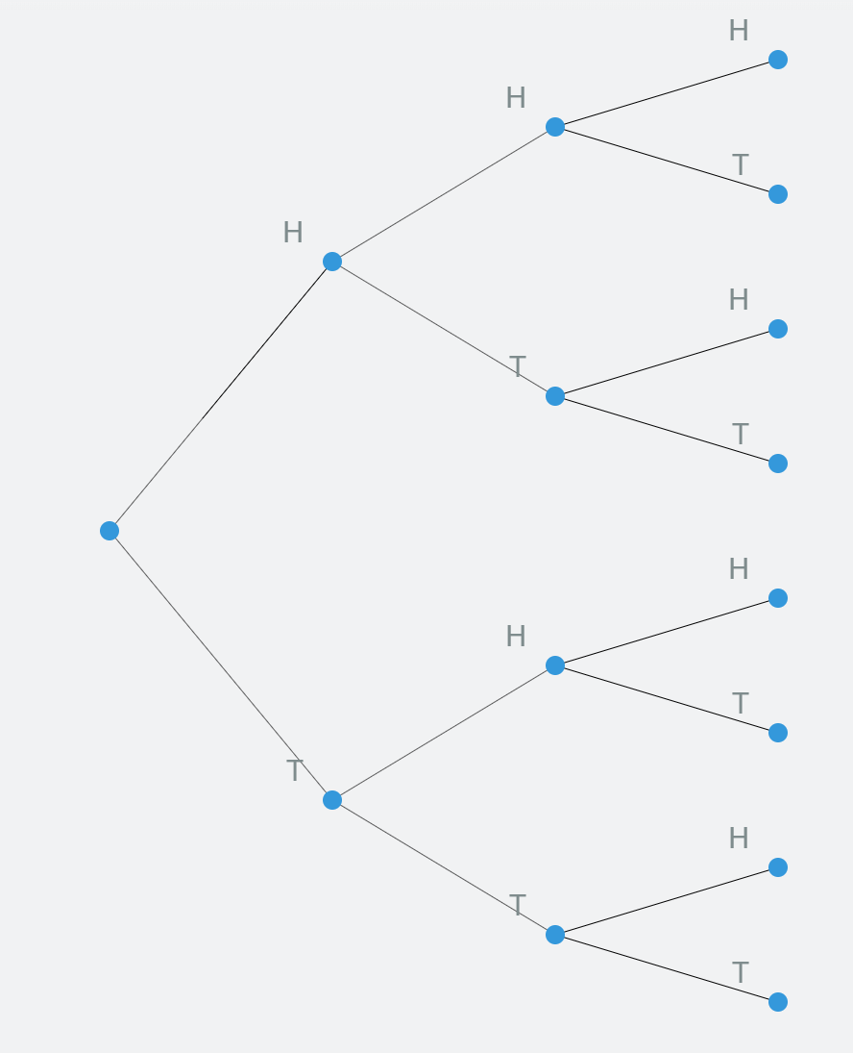
Daily Review
What is the probability of getting:
1/8
Three heads?

Slide 10
Daily Review
What is the probability of getting:
1/8
Three heads?
1/8
Three tails?

Slide 11
Daily Review
What is the probability of getting:
1/8
Three heads?
1/8
Three tails?
1/8
No tails?

Slide 12
Daily Review
What is the probability of getting:
1/8
Three heads?
1/8
Three tails?
1/8
No tails?
Exactly one tail?
3/8

Slide 13
Daily Review
What is the probability of getting:
1/8
Three heads?
1/8
Three tails?
1/8
No tails?
Exactly one tail?
3/8
7/8
At least one head?

Slide 14
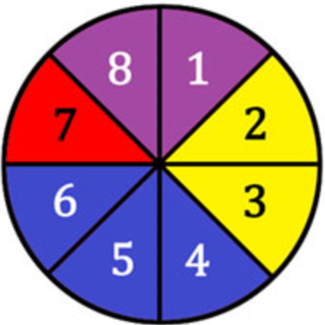
Learning Objective
CFU 1
What will we learn?
I will calculate probabilities from tree diagrams.
CFU 2
What will we learn?
Success Criteria
I will be able to list sample spaces.
I will be able to calculate probabilities of multiple events.
I will be able to interpret tree diagrams.
I will be able to calculate probabilities of multiple events that
are not equally likely.

Slide 15

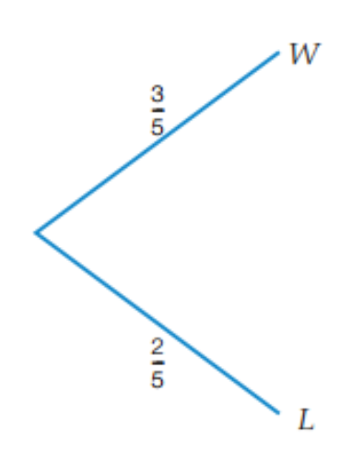
Concept Development
If the outcomes are not equally likely, we cannot just count how many successful outcomes there are.
Peach and Mario play a game of golf. Peach’s chance of winning any single game is 3/5.
There are two outcomes, Peach wins or Peach loses (Mario wins). However, they are not equally likely.
Pr(W) = 3/5 and Pr(L) = 2/5

Slide 16

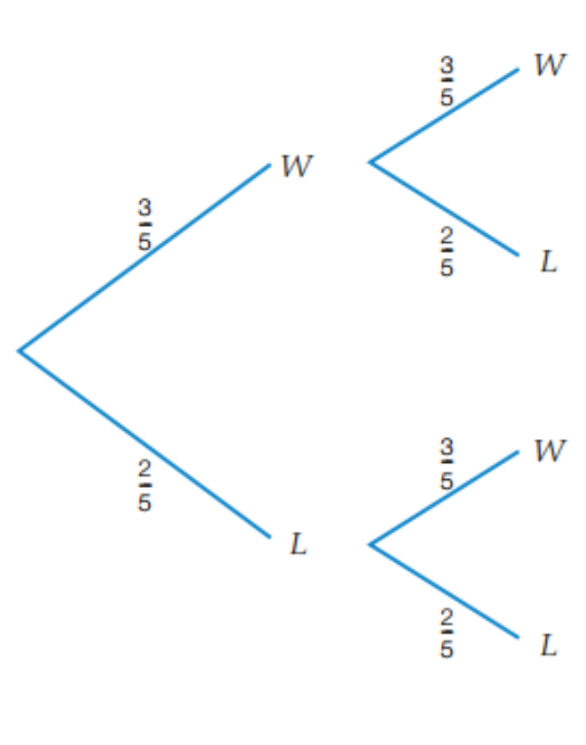
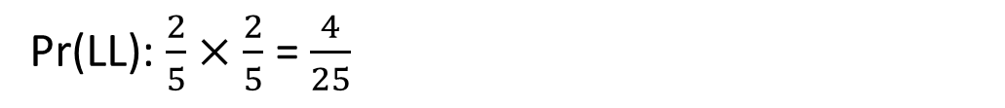
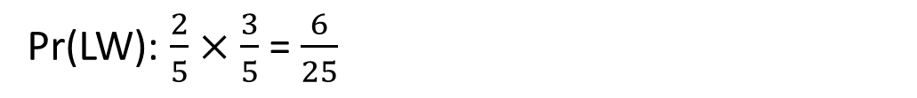
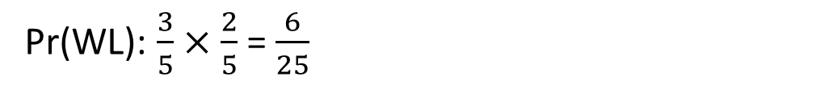
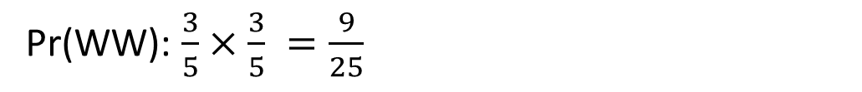
Skill Development
Peach and Mario play two games of golf. Peach’s chance of winning any single game is 3/5.
There are four outcomes. Peach wins both games, Peach wins the 1st game and loses the 2nd, Peach loses the 1st game and wins the 2nd and Peach loses both games.
Pr(WW): $\frac{3}{5}×\frac{3}{5} =\frac{9}{25}$
Pr(WL): $\frac{3}{5}$ $×$ $\frac{2}{5}$ = $\frac{6}{25}$
Pr(LW): $\frac{2}{5}$ $×$ $\frac{3}{5}$ = $\frac{6}{25}$
Pr(LL): $\frac{2}{5}$ $×$ $\frac{2}{5}$ = $\frac{4}{25}$

Slide 17
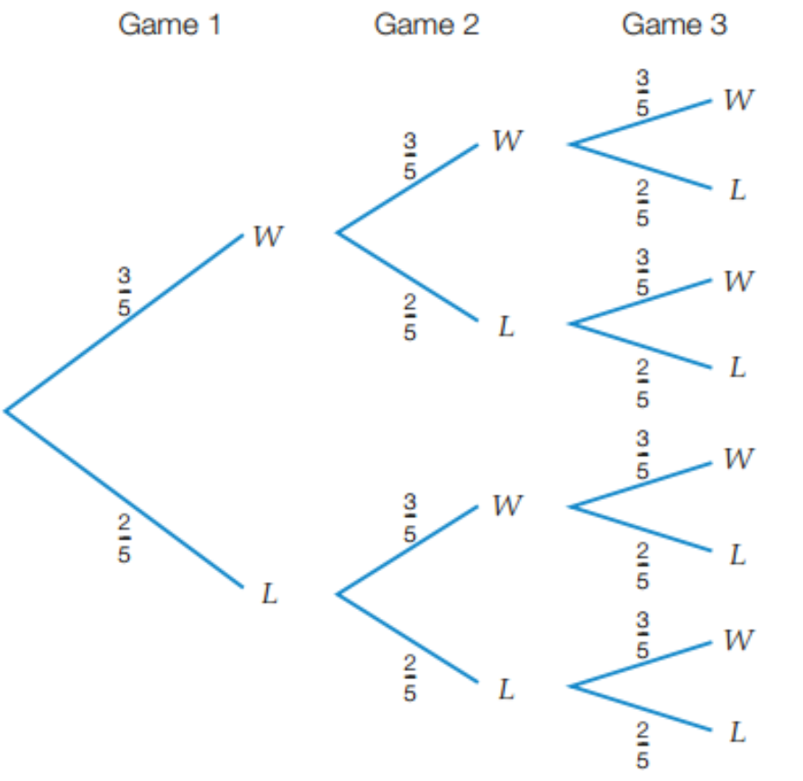








Skill Development
Peach and Mario play three games of golf. Peach’s chance of winning any single game is 3/5.
There are eight outcomes:
Pr(WWW): ): $\frac{3}{5}×\frac{3}{5}×\frac{3}{5}=\frac{27}{125}$
Pr(WWL):$\frac{3}{5}×\frac{3}{5}×\frac{2}{5}=\frac{18}{125}$
Pr(WLW): $\frac{3}{5}×\frac{2}{5}×\frac{3}{5}=\frac{18}{125}$
Pr(WLL): $\frac{3}{5}×\frac{2}{5}×\frac{2}{5}=\frac{12}{125}$
Pr(LWW): $\frac{2}{5}×\frac{3}{5}×\frac{3}{5}=\frac{18}{125}$
Pr(LWL): $\frac{2}{5}×\frac{3}{5}×\frac{2}{5}=\frac{12}{125}$
Pr(LLW): $\frac{2}{5}×\frac{2}{5}×\frac{3}{5}=\frac{12}{125}$
Pr(LLL): $\frac{2}{5}×\frac{2}{5}×\frac{2}{5}=\frac{8}{125}$

Slide 18
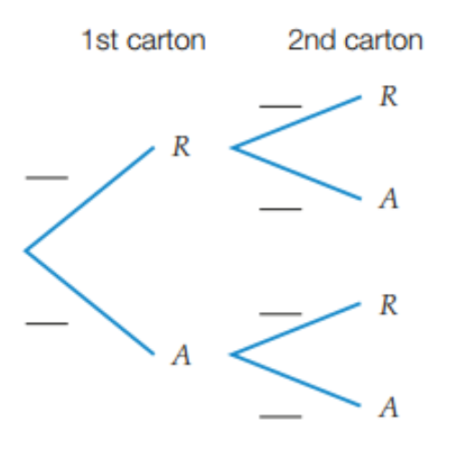




Guided Practice
At Coles, cartons of eggs are inspected for broken shells before they are put on the shelves. The probability a carton of eggs is rejected is 1/10. Two cartons of eggs are inspected.
Draw a tree diagram that represents this situation (use R for rejected and A for accepted).
Find the probability that both cartons are rejected.
Find the probability that one carton is rejected.
There are four outcomes.
b) The probability that both cartons are rejected is
Pr(RR) = 1/100.
1/10
Pr(RR): $\frac{1}{10}×\frac{1}{10}=\frac{1}{100}$
1/10
9/10
Pr(RA): $\frac{1}{10}×\frac{9}{10}=\frac{9}{100}$
c) The probability that one carton is rejected is Pr(RA) + Pr(AR)
= 9/100 + 9/100
= 18/100 simplified to 9/50
9/10
1/10
Pr(AR): $\frac{9}{10}×\frac{1}{10}=\frac{9}{100}$
9/10
Pr(AA): $\frac{9}{10}×\frac{9}{10}=\frac{81}{100}$

Slide 19

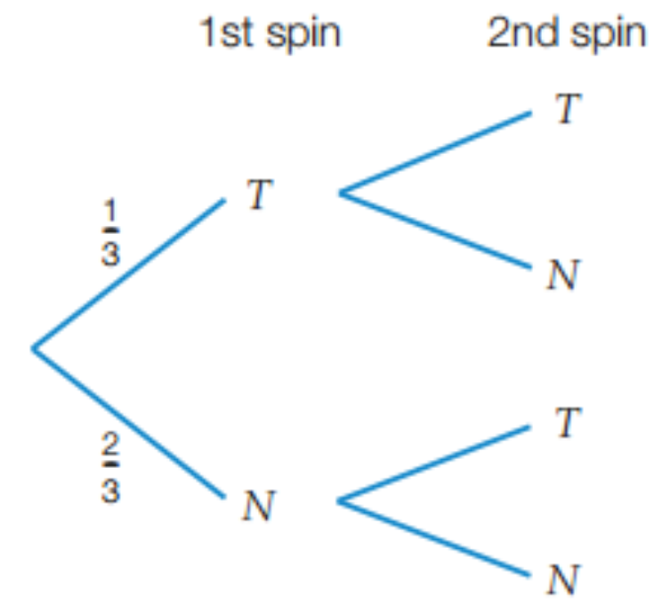




Guided Practice
A spinner numbered 1 to 3 is spun twice. Let T represent the
spinner lands on 2 and N represent the spinner does not land on 2.
Draw a tree diagram that represents this situation
Find the probability of spinning 2 twice. c) Find the probability of spinning 2 once.
d) Find the probability of spinning 2 at least once. e) Find the probability of not spinning 2.
1/3
Pr(TT): $\frac{1}{3}×\frac{1}{3}=\frac{1}{9}$
2/3
Pr(TN): $\frac{1}{3}×\frac{2}{3}=\frac{2}{9}$
Pr(NT): $\frac{2}{3}×\frac{1}{3}=\frac{2}{9}$
1/3
2/3
Pr(NN): $\frac{2}{3}×\frac{2}{3}=\frac{4}{9}$

Slide 20
Guided Practice
A spinner numbered 1 to 3 is spun twice. Let T represent the
spinner lands on 2 and N represent the spinner does not land on 2.
Draw a tree diagram that represents this situation
Find the probability of spinning 2 twice. c) Find the probability of spinning 2 once.
d) Find the probability of spinning 2 at least once. e) Find the probability of not spinning 2.
b) The probability of spinning 2 twice is
Pr(TT): 1/9
Pr(TT) = 1/9
1/3
c) The probability of spinning 2 once is
Pr(TN) + Pr(NT): 2/9 + 2/9 = 4/9
Pr(TN) = 2/9
2/3
d) The probability of spinning 2 at least once is
Pr(TT) + Pr(TN) + Pr(NT) = 1/9 + 2/9 + 2/9 = 5/9
Pr(NT) = 2/9
1/3
e) The probability of not spinning 2 is
Pr(NN) = 4/9
Pr(NN) = 4/9
2/3

Slide 21




Independent Practice
Mathspace – Year 10 Mainstream Tree Diagrams With Replacement CLASSWORK
There are four outcomes.
b) The probability that both cartons are rejected is
Pr(RR) = 1/100.
1/10
Pr(RR): $\frac{1}{10}×\frac{1}{10}=\frac{1}{100}$
1/10
9/10
Pr(RA): $\frac{1}{10}×\frac{9}{10}=\frac{9}{100}$
c) The probability that one carton is rejected is Pr(RA) + Pr(AR)
= 9/100 + 9/100
= 18/100 = 9/50
9/10
1/10
Pr(AR): $\frac{9}{10}×\frac{1}{10}=\frac{9}{100}$
9/10
Pr(AA): $\frac{9}{10}×\frac{9}{10}=\frac{81}{100}$

